Slide 1

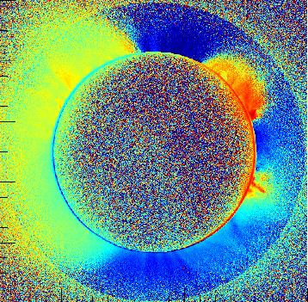
Coronal Spectro-polarimetry with the Turin Lyot-Filter
Silvano Fineschi
INAF – Astrophysical Observatory of Torino, Italy
Future of Polarimetry - Brussels (B) – 21-23 September 2015

Slide 2
OUTLINE
Hanle effect of line linear polarization by resonance scattering as diagnostics tool to probe the coronal magnetic fields
Turin Liquid Crystal spectro-polarimeter for Coronal Magnetography (CorMag)
2010 Eclipse observations of the coronal FeXIV 530.3 nm linear polarization.
CorMag at Lomnicky Observatory – STSM of COST Action MP1104
Future spectro-polarimeters for ground- and space-based coronal magnetometers

Slide 3
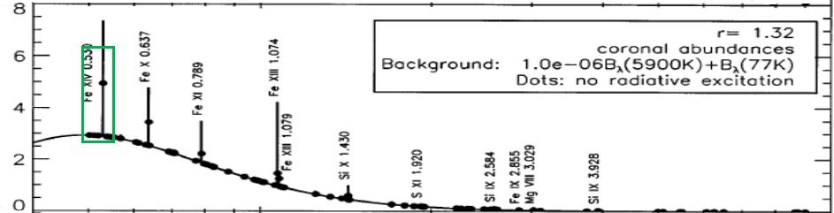
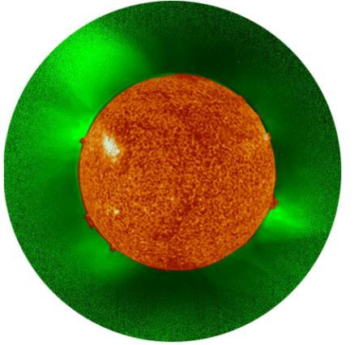
Fe XIV 530.3 nm (“Green Line”)
FeXIV line 530.3 nm
(configuration 3s² 3p) is a magnetic dipole transition:
²P_{3/2} → ²P_{1/2}
Notes:
cut a 1.2

Slide 4
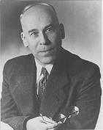
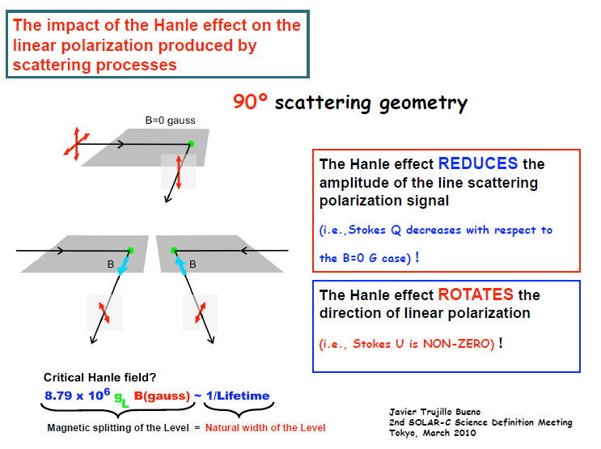
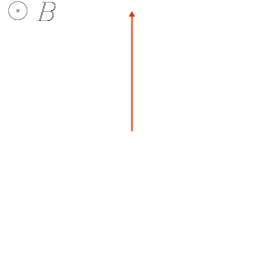
Hanle Effect (tutorial)
ω_{Larmour} ∼ A

Slide 5
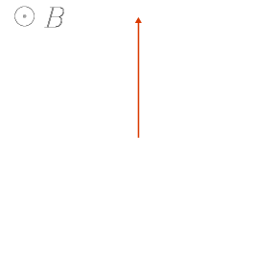
Hanle Effect (tutorial)
If ω_{Larmour} >> A (VIR forbidden lines)
⇓
P is // or ⊥ B
ω_{Larmour} ∼ A

Slide 6
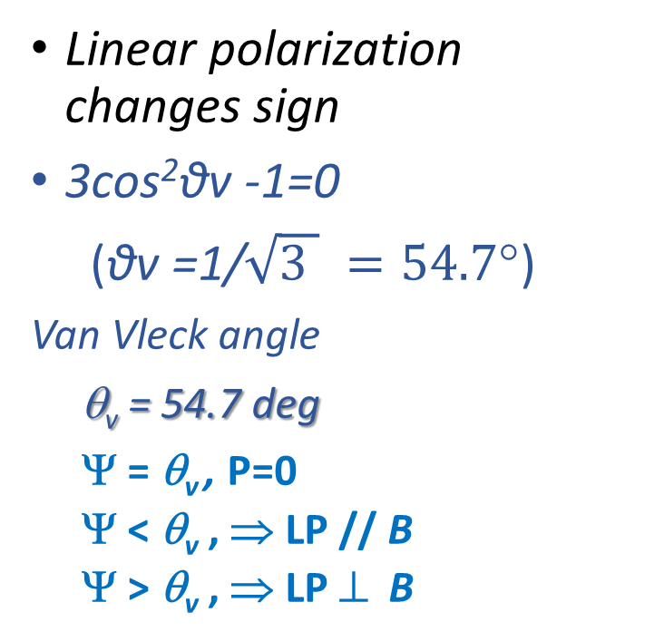
Polarization vector
Van Vleck angle
Line Polarization Vector
Linear polarization changes sign
3cos²θv -1=0
(θv =1/$\sqrt{3 } =54.7°$)
Van Vleck angle
θ_{v} = 54.7 deg
Ψ = θ_{v} , P=0
  Ψ < θ_{v} , ⇒ LP // B
  Ψ > θ_{v} , ⇒ LP ⊥ B
Ψ > θ_{v}
Ψ < θ_{v}
“Saturated” Hanle effect
ω_{Larmour} >> A

Slide 7

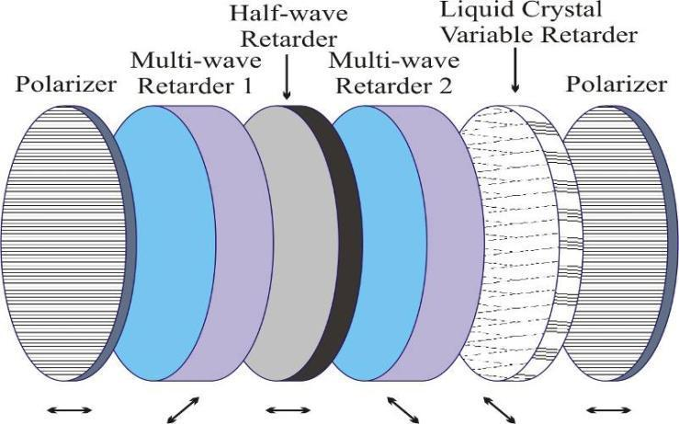
Turin - Liquid-crystal Tunable Lyot Filter
for Solar Coronagraphy

Slide 8
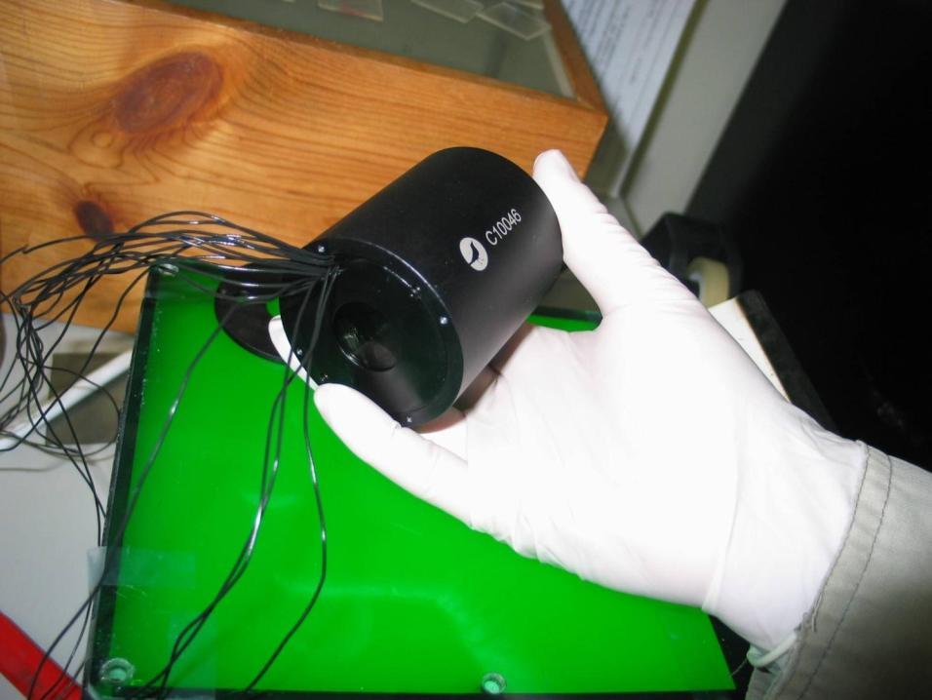
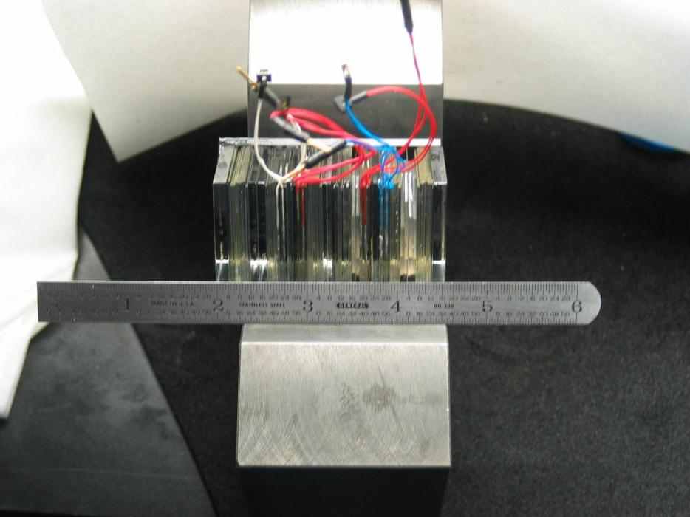
LC Tunable-filter & Polarimeter Procurement

Slide 9
Turin - Liquid-crystal Tunable Lyot Filter
Perfomances

Slide 10
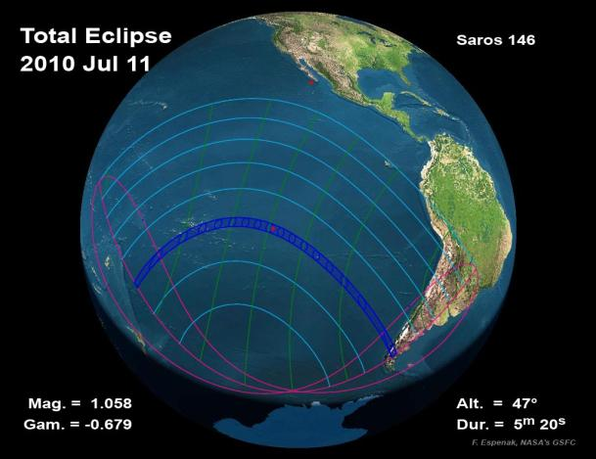
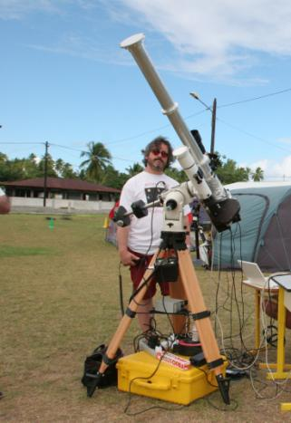
Turin – Coronal Magnetograph - CorMag
The CorMag was operated during the total solar eclipse of July, 11th 2010 on Tatakoto Atoll (French Polynesia)

Slide 11
2010 Eclipse Results of CorMag

Slide 12
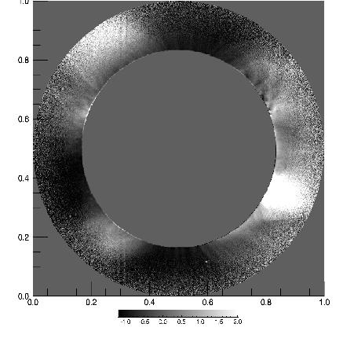
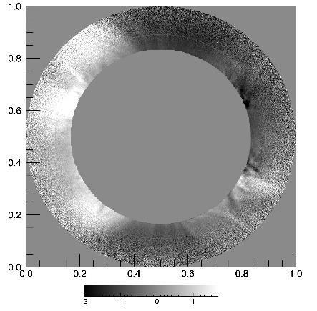
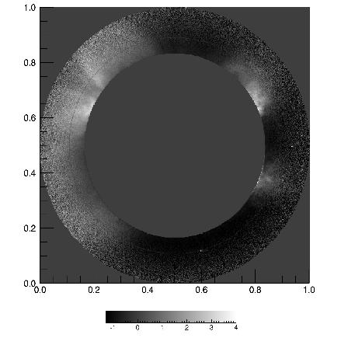
Measured Stokes Paramenters of FeXIV Line
I
Q
U
Notes:
In this slide we can see on the right side the Stokes parameters I obtained from observative date in the k corona and on the left side the same parameter obtain from simulations. There is a quite agreement between these two images.

Slide 13
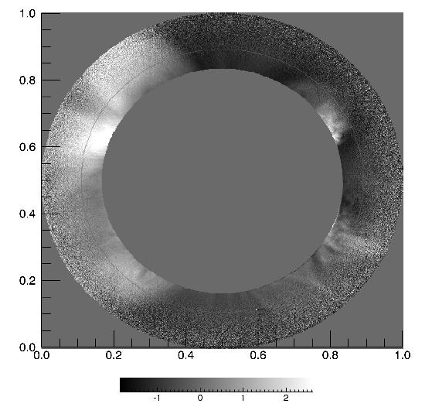
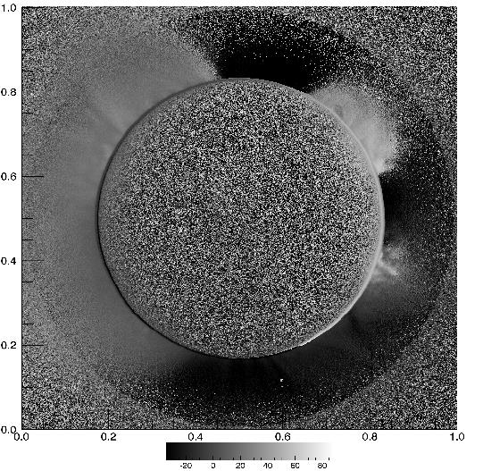
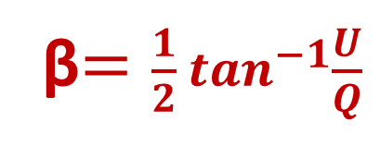
FeXIV Line Polarization Vector
β$=\frac{1}{2}\tan^{−1}{\frac{U}{Q}}$
pB
β

Slide 14
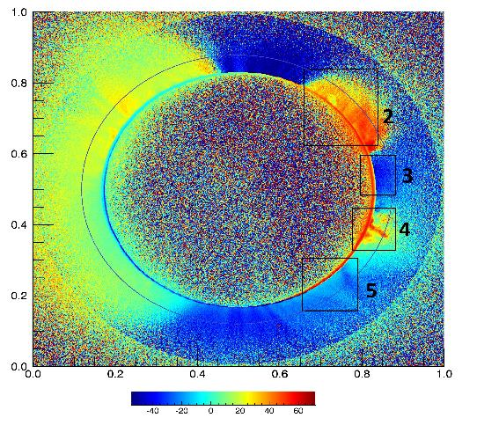
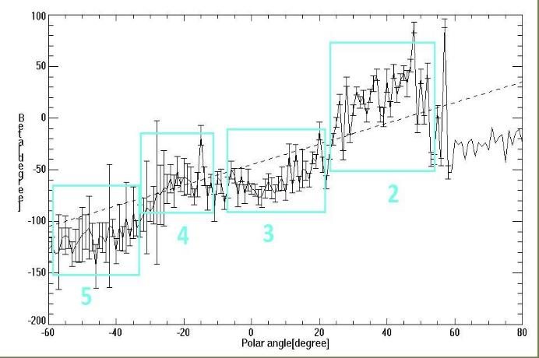
«Saturated» Hanle effect in the Coronal FeXIV Line
Ψ > θ_{v}
Ψ < θ_{v}

Slide 15
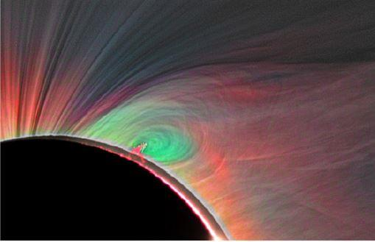
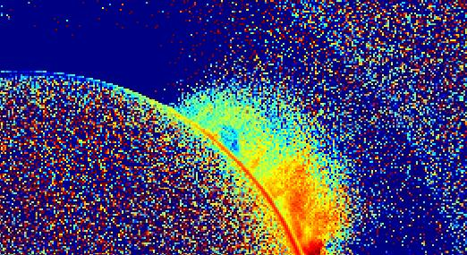
Coronal Cavity
Left: M. Druckmuller imaging (spatial resolution 1’’).
Right: CorMag polarization vector direction (res. 12.4’’).

Slide 16
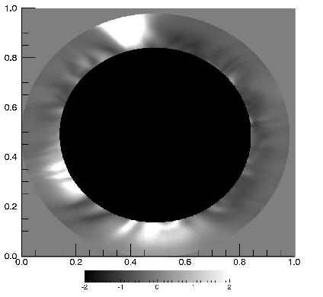

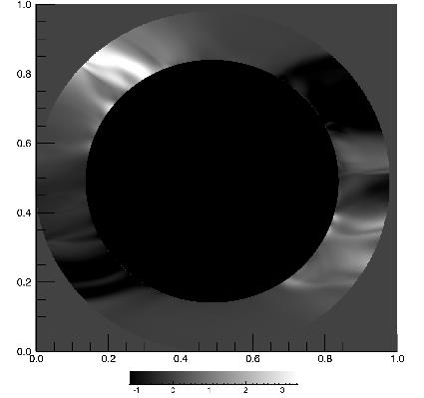
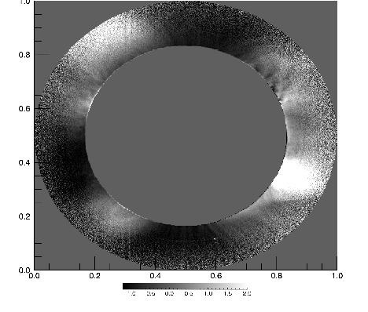
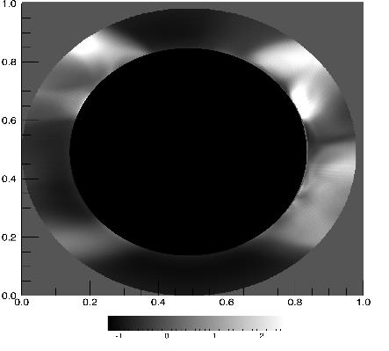
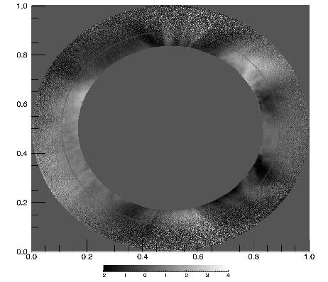
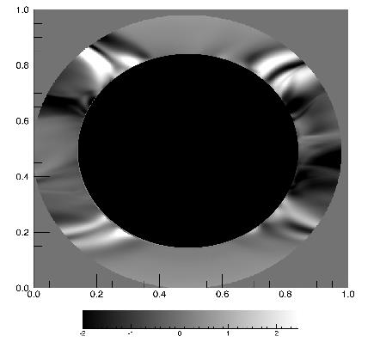

E Corona Forward modeling (LOS)
vs
CorMag observations
p
I
I
Q
p
U
Q
U
Forward modeling:
Predictive Science MHD model &
FORWARD Code (S. Gibson)
CorMag Observations

Slide 17
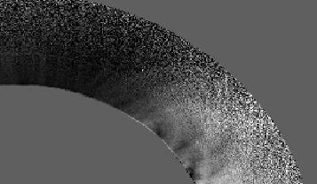

US High Altitude Observatory
Forward modeling vs
CorMag observations
I
I
Model of global solar magnetic field based on extrapolation from phototospheric magnetograms (averaged over a Carrington rotation do) not include transient structures
I

Slide 18
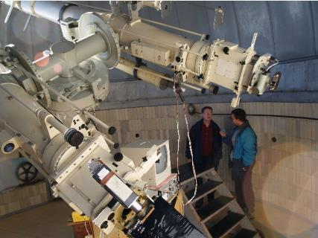
INAF-Turin CorMag (Italy) at
Lomnicky Stit Observatory (Slovakia)
COST Short Term Scientific Missions
LSO contact: Dr. Jan Rybak
October 2013
April 2014
June 2014
September 2015

Slide 19
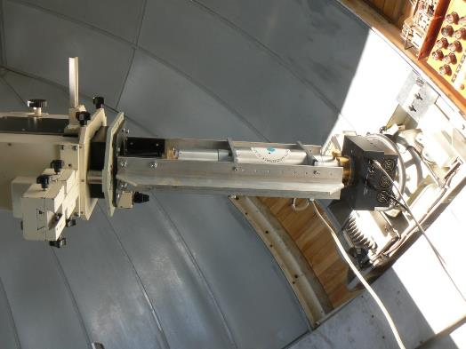
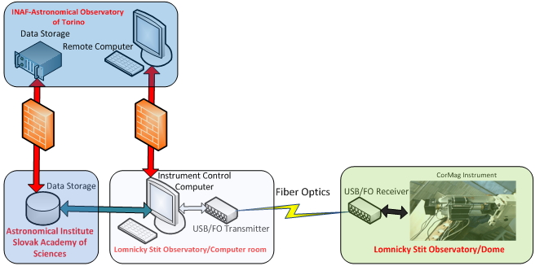
Turin CorMag at
Lomnicky Stit Observatory (Slovakia)
STSM October 2013, April 2014:
Opto-mech coupling filter-coronagraph
Control & Data Acquisition system

Slide 20
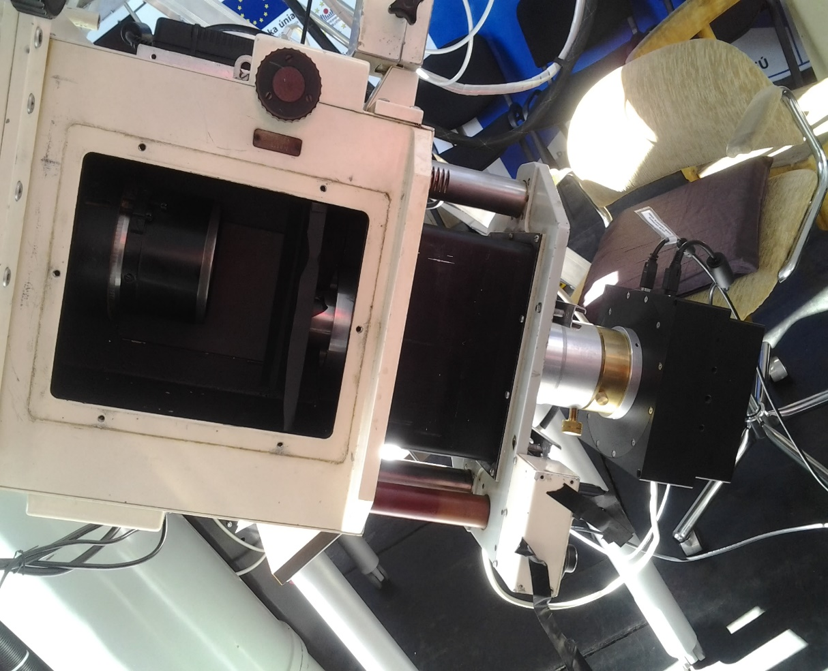
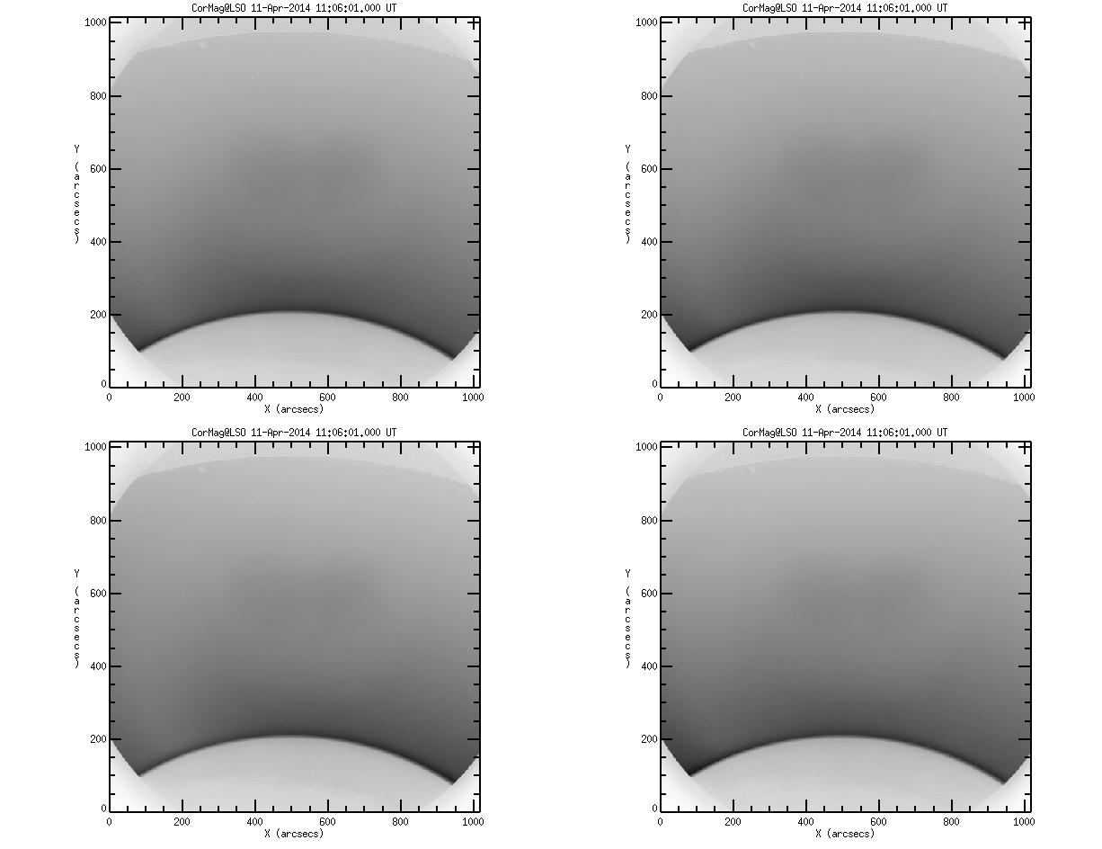
Turin CorMag at
Lomnicky Stit Observatory (Slovakia)
STSM June 2014:
Changed filter-coronagraph optical coupling: collimated beam => focussed
First light

Slide 21
Turin CorMag at
Lomnicky Stit Observatory (Slovakia)
STSM September 2015:
Cleaned Turin-filter from optical oil leak => removed parasitic ghosts

Slide 22
Turin CorMag at
Lomnicky Stit Observatory (Slovakia)
Lesson learned:
Optical coupling Filter-Coronagraph => single system
Climatic conditions: thermal, coronal sky is rare.
Instrumental cleanliness for coronal observations
(both Filter & Coronagraph)

Slide 23
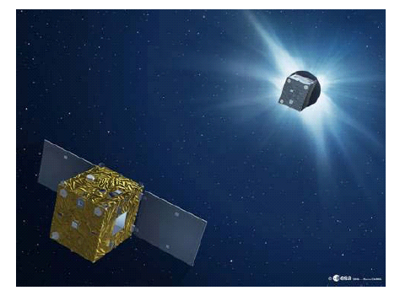
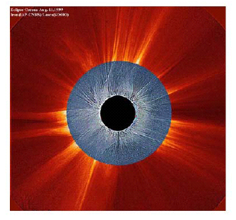
ESA PROBA-3 Formation-Flying Coronagraph
A coronagraph with the external occulter on one spacecraft and the optical instrument on the other spacecraft at ~150 meters from the first one.
Proba-3 – ESA: launch 2018. ASPIICS: 2009 selection; 2010 Phase-A; 2011 Phase-B; Phase C/D 2015

Slide 24
Summary
Spectro-polarimetry of coronal line-emission in the visible-light wavelength spectrum («forbidden lines») have demonstrated to yield a valuable diagnostics tool of the coronal magnetic field
Turin CorMag installed at one of the two the coronagraphs of the Lomnicky Stit Observatory thanks to COST Action 1104 STSM.
Ground based coronagraphs provides valuable «test-beds» for new space-based observatories with visible-light spectro-polarimetry

Slide 25
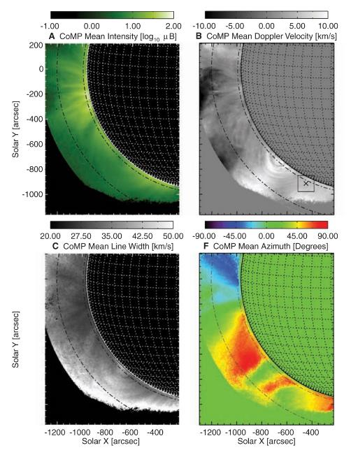
HAO CoMP
LC Lyot filter
& Polarimeter
(FeXIII 1074-7 nm))
S. Tomczyk, et al.
Science 317, 1192 (2007);

