Slide 1


SPEX
accurate spectrally modulating polarimeters for atmospheric aerosol characterization
Jeroen Rietjens
Martijn Smit¹, Gerard van Harten², Antonio Di Noia¹, Otto P. Hasekamp¹, Jozua de Boer², Hester Volten³, Frans Snik², and Christoph U. Keller²
1
2
3

Slide 2
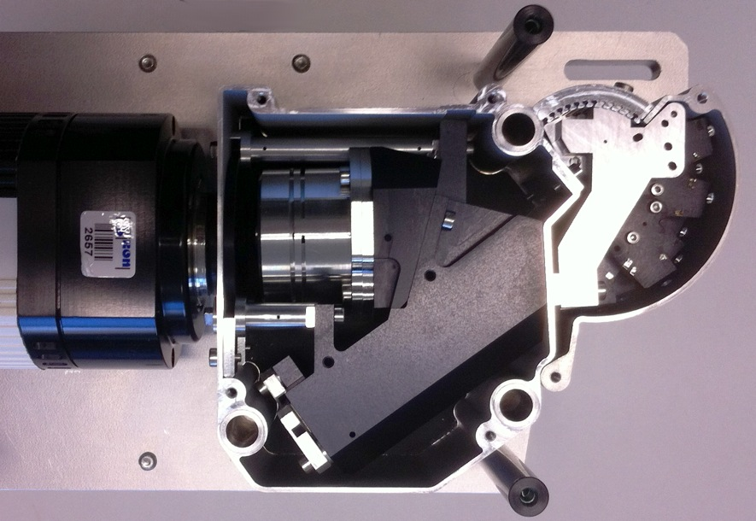
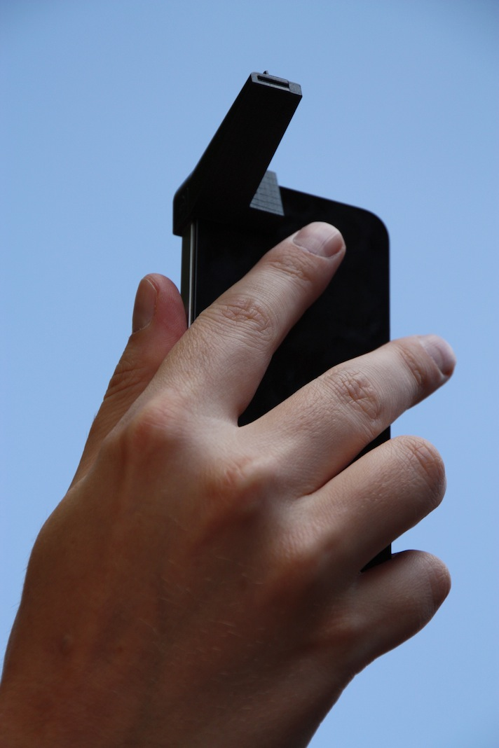
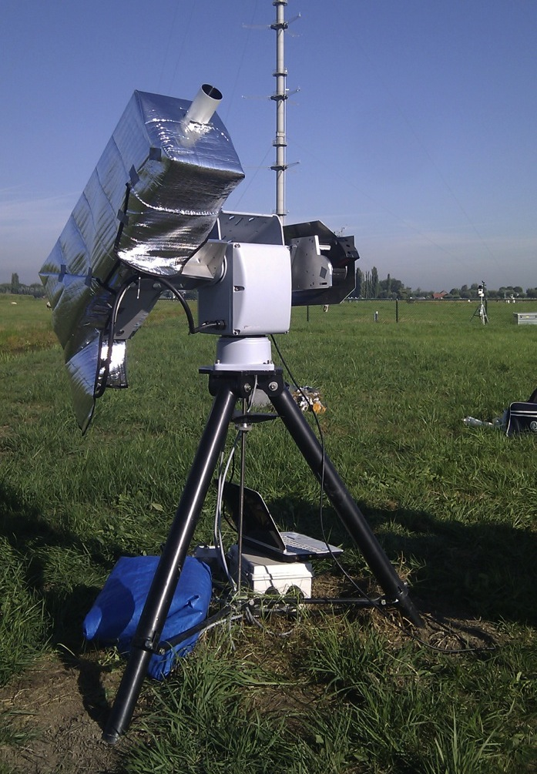
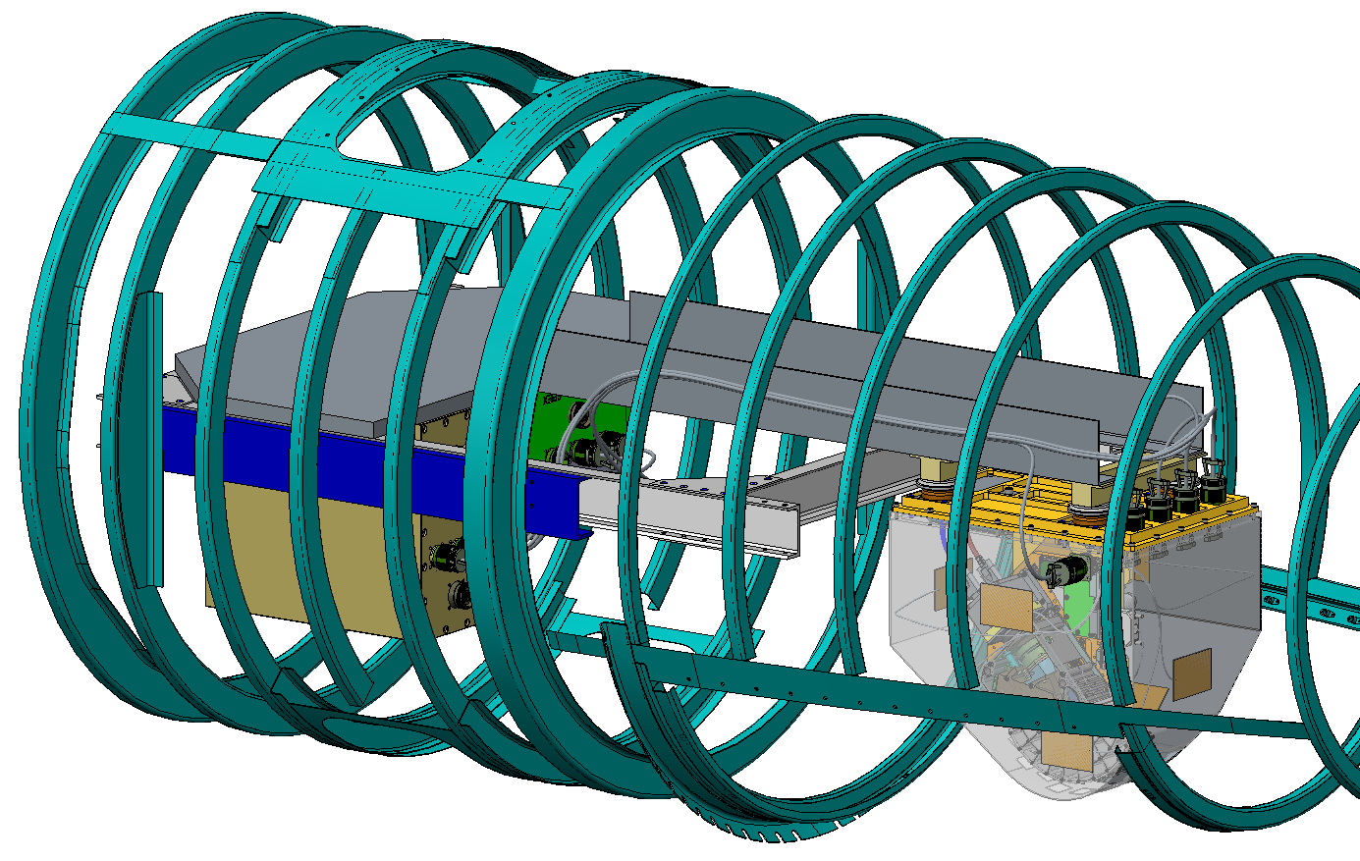
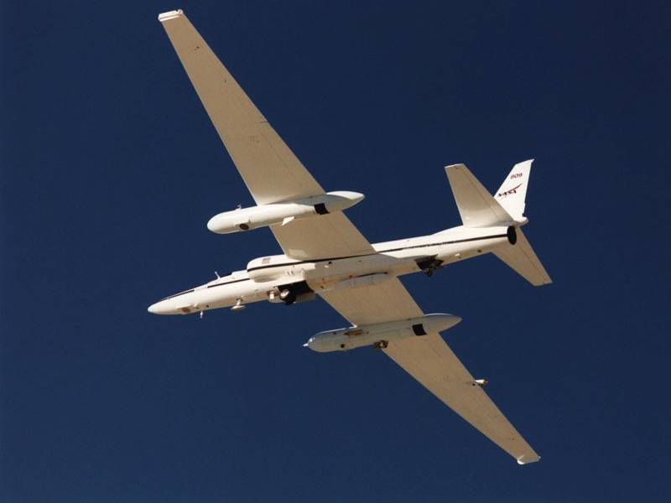
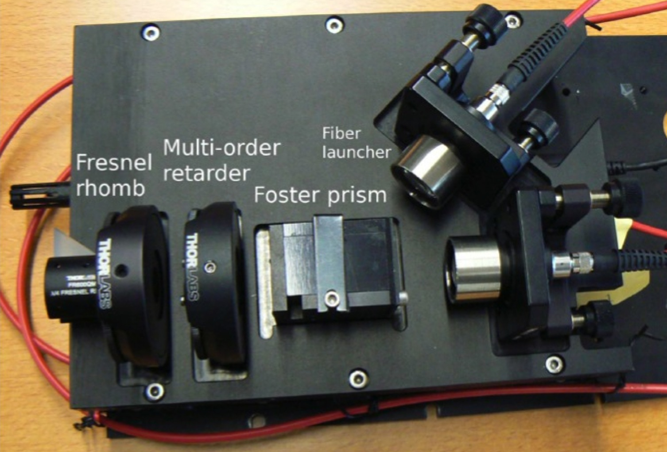
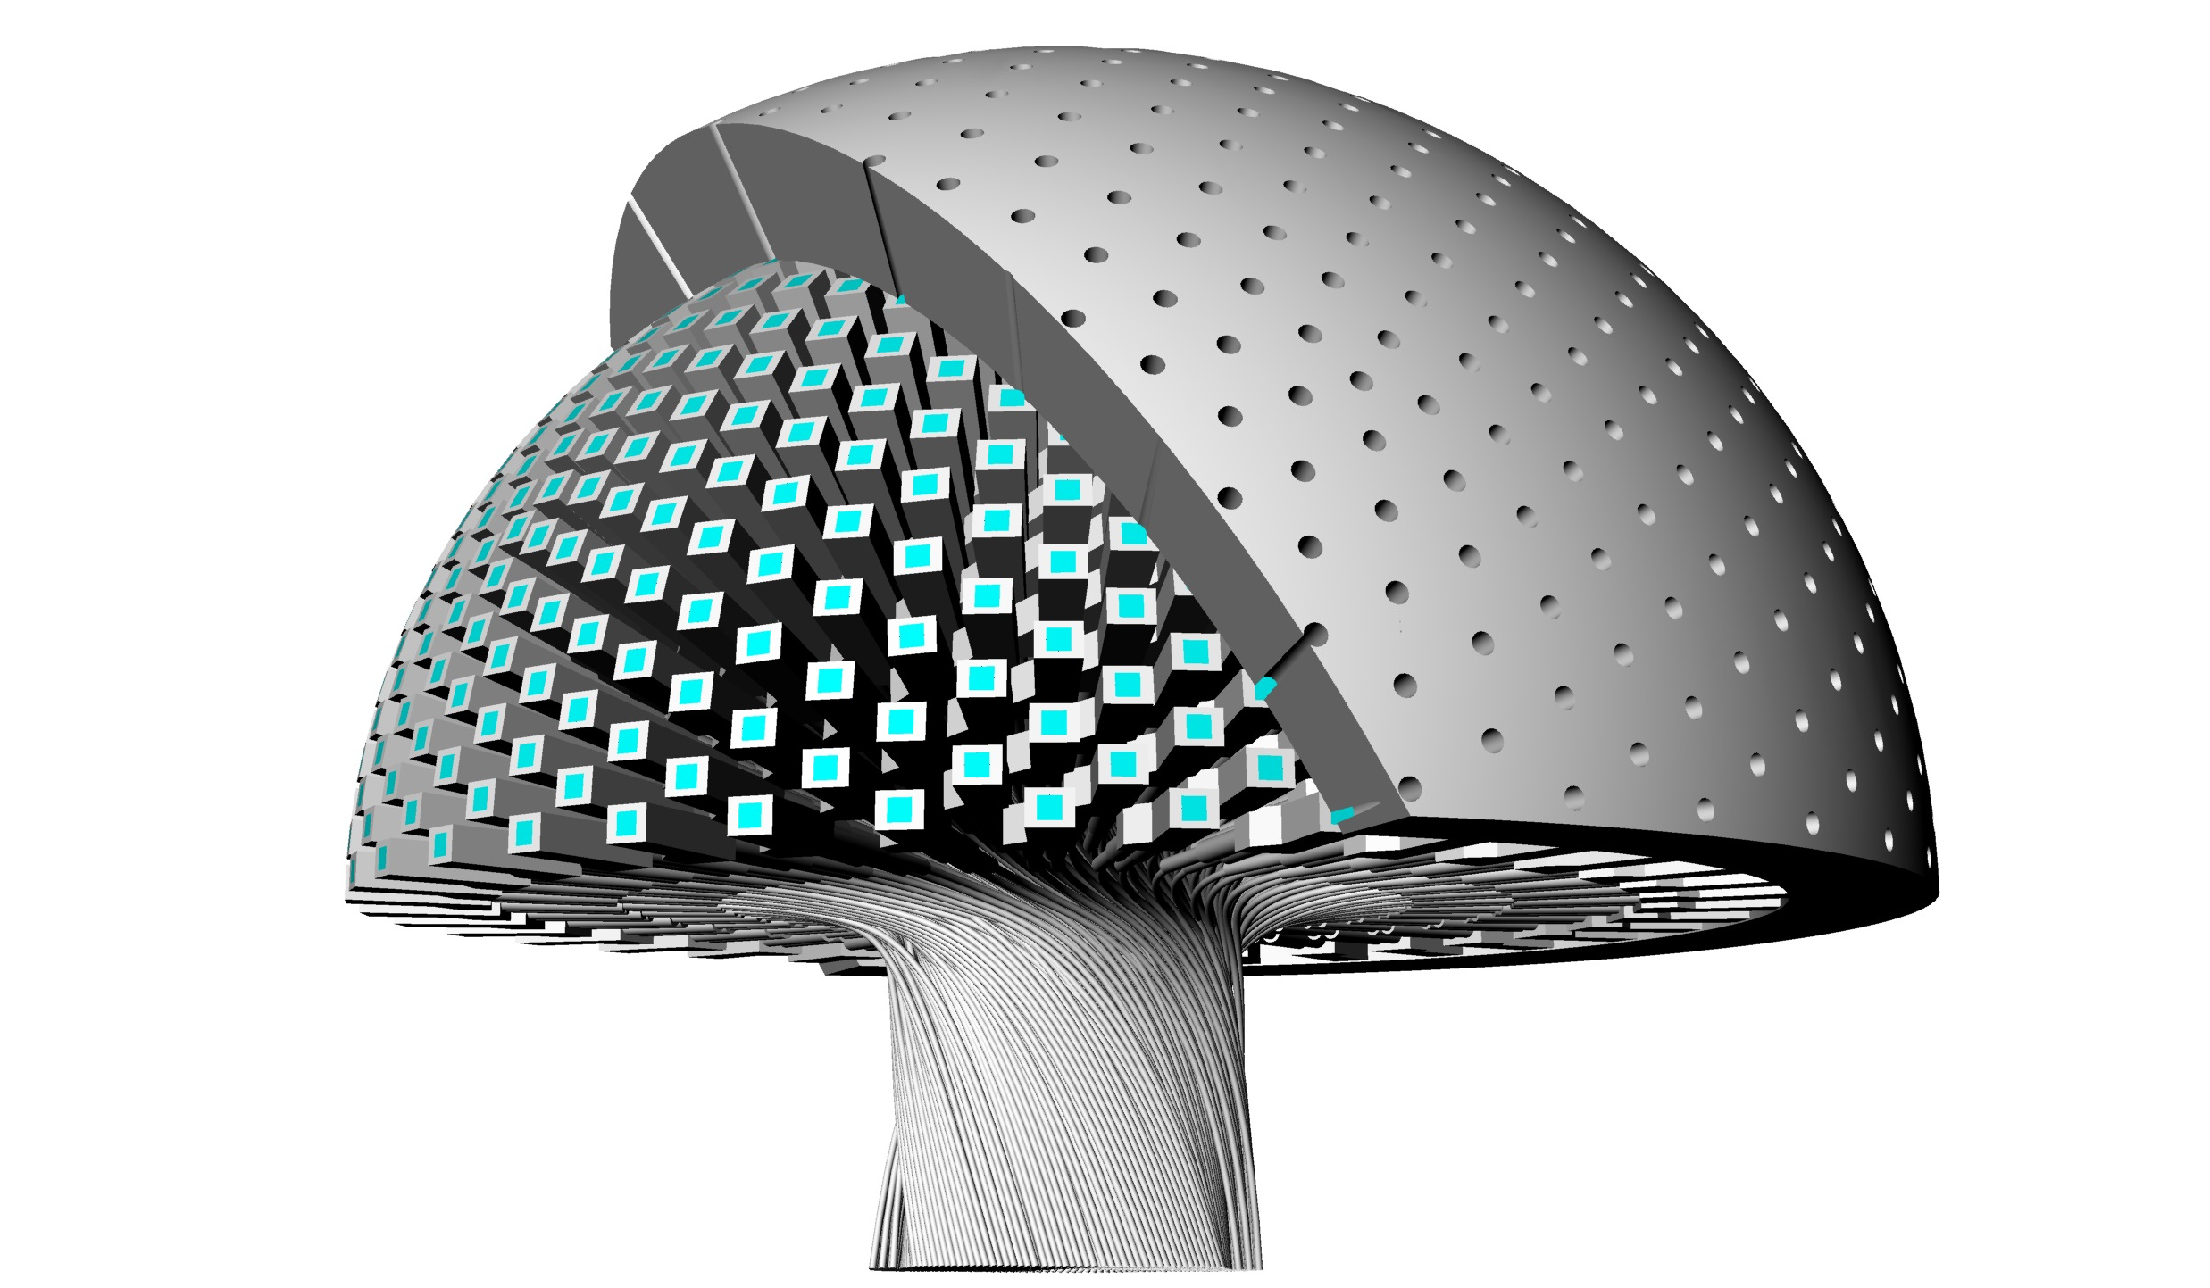
Spectrally modulating polarimeters
SPEX prototype
iSPEX
groundSPEX
flySPEX concept
SPEX airborne
Keller & Snik
(2014) patent

Slide 3
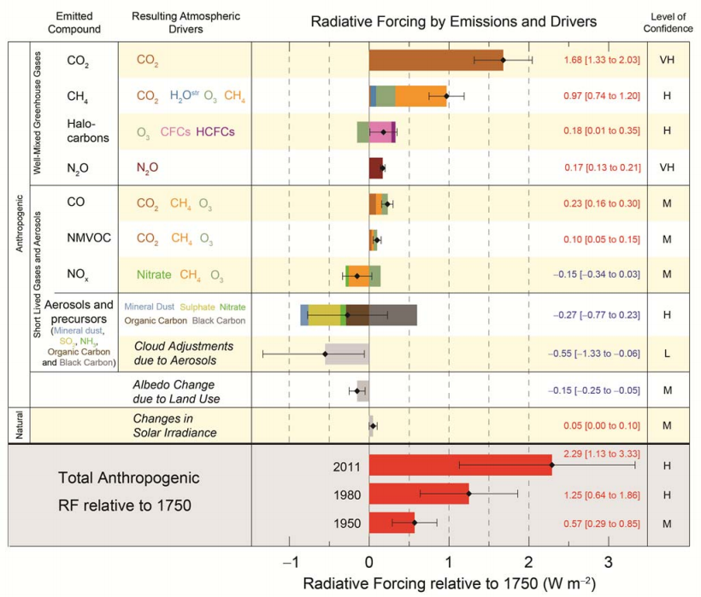
IPCC, Radiative Forcing, Future Climate
Steps to be taken
Quantifying present day aerosol radiative forcing
Understanding present day aerosol radiative forcing
Predicting future changes in aerosol radiative forcing.
IPCC, AR5, 2013
Notes:
For Aerosol: beginning of step 1
For CO2, CH4 at step 2

Slide 4


Aerosols & Climate
Needed (globally):
Refractive index
(composition, water uptake).
Size, shape, and concentration
Optical properties
(AOT, SSA, phase function)
Measurements close to and above clouds
Multi-angle photo-polarimetry essential to retrieve the relevant aerosol properties: ΔP_{L} < 0.001 + 0.005 • P_{L}
Mishchenko and Travis, JGR, 2007, Mishchenko et al., 2004
Hasekamp and Landgraf, Appl. Opt., 2007
Kokhanovsky et al, AMT, 2010
Loeb and Su, 2010

Slide 5
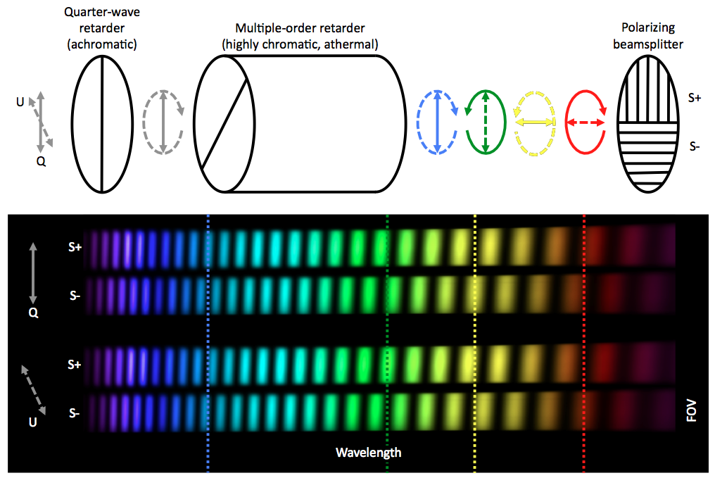
Spectral polarization modulation
Courtesy: Gerard van Harten

Slide 6


Spectral polarization modulation
DoLP
AoLP
Courtesy: Gerard van Harten

Slide 7
Instrument concept
Advantages of spectral modulation
Instantaneous (one shot) polarimetry
→ No timing issues
Passive optical components
→ High stability and reliability
No differential effects
Disadvantages of spectral modulation
Spectrometer
→ Requirement on stability and image quality
Spectral oversampling
→ More detector pixels, higher data volume

Slide 8
Instrument concept
Advantages of spectral modulation
Instantaneous (one shot) polarimetry
→ No timing issues
Passive optical components
→ High stability and reliability
No differential effects
Dual beam implementation
Radiance at full spectrometer resolution
No aliasing
→ High accuracy of radiometry and polarimetry
→ Line polarimetry
Redundancy
→ differential transmission correction
Beam-exchange equivalent
→ Using spectral and spatial dimensions

Slide 9
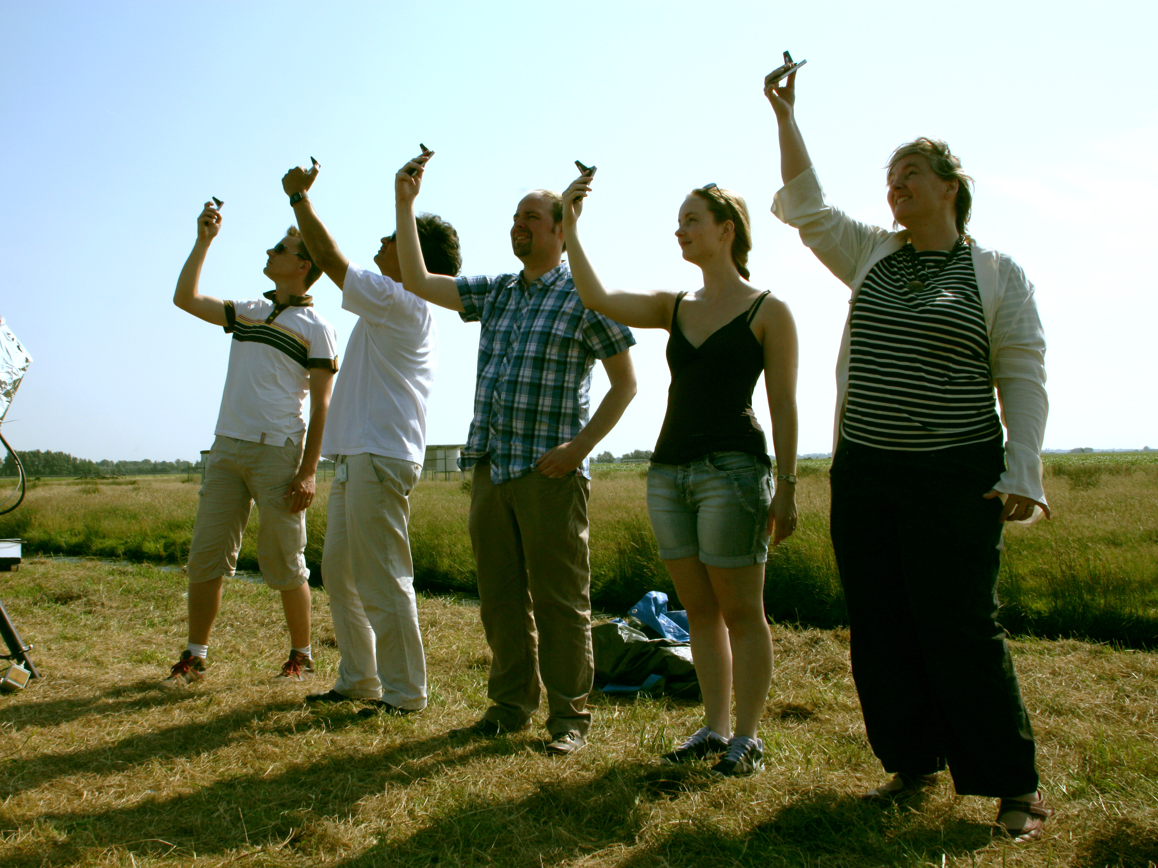
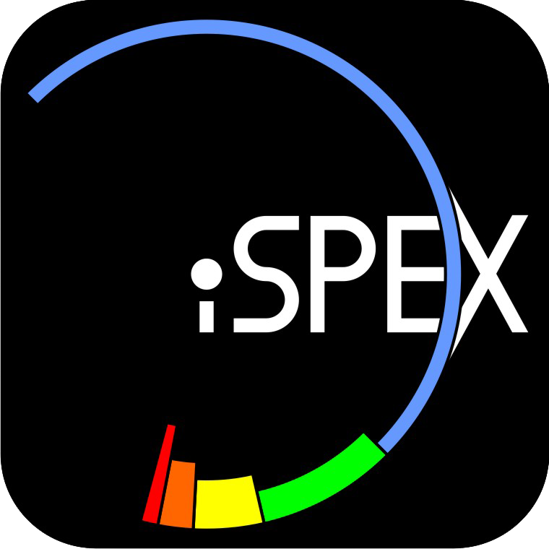
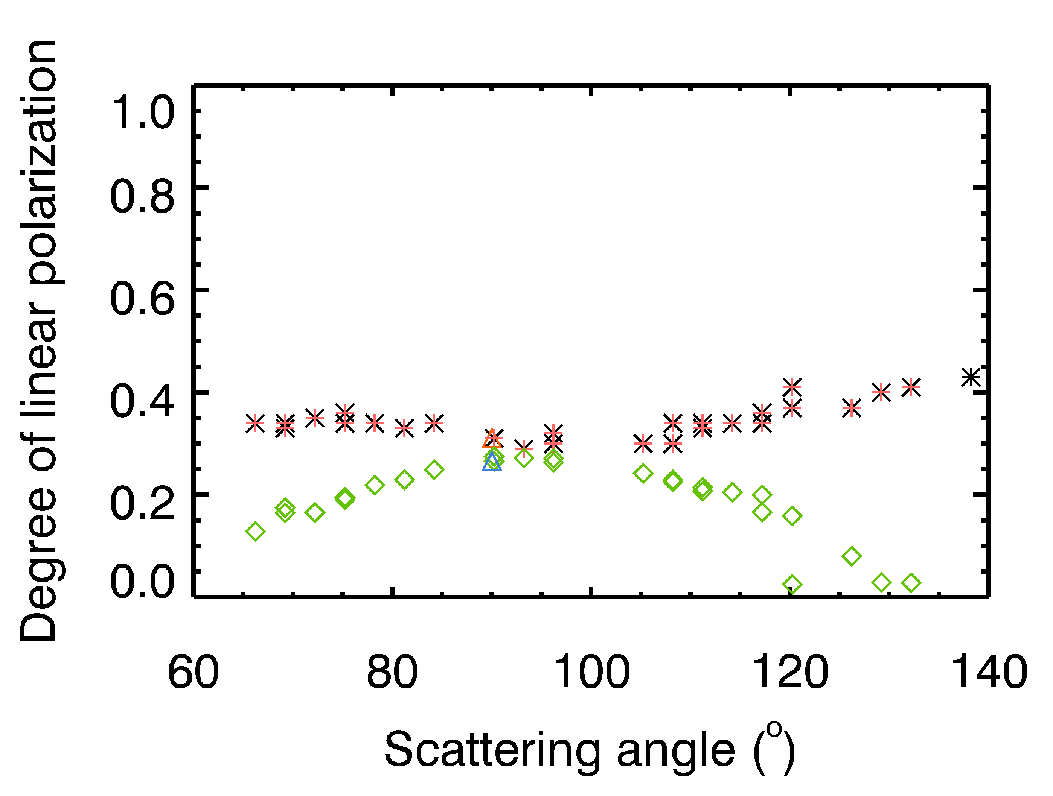
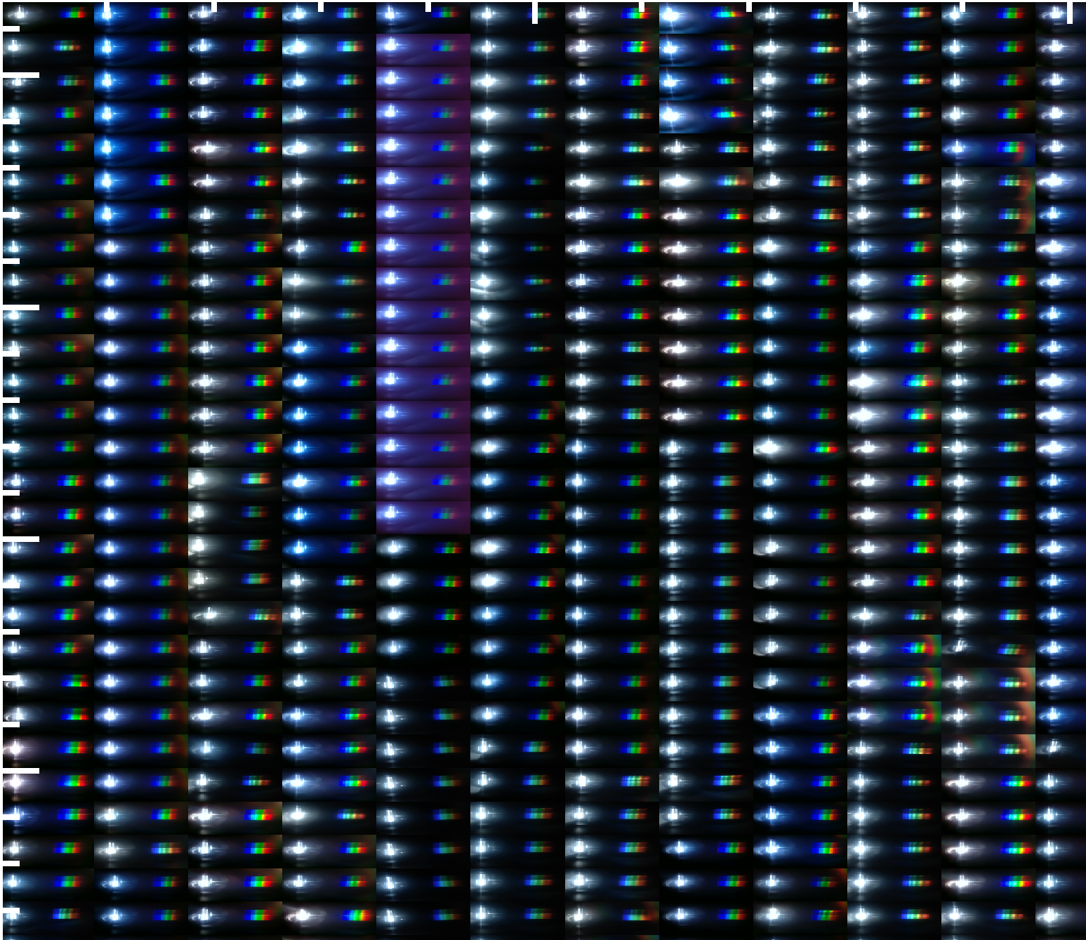
Snik, Rietjens et al., GRL 2014

Slide 10
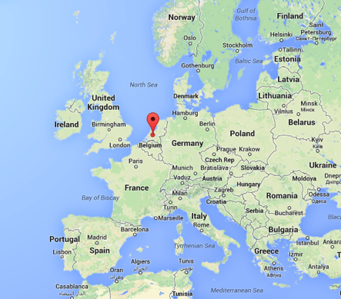
“CESAR” meteorological site in Cabauw, the Netherlands
Ground based measurements
Two SPEX realizations
  SPEX prototype
  groundSPEX
Sky-sweeps to obtain multi-angle measurements
Retrieval scheme based on algorithm for POLDER
(Hasekamp+, JGR, 2011)
Comparison with AERONET products from CIMEL Sun Photometer measurements

Slide 11
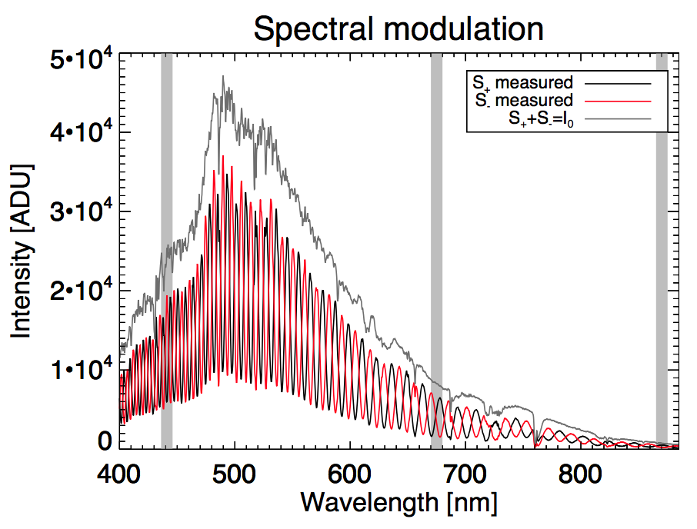
Ground based measurements
groundSPEX van Harten+, AMT, 2014

Slide 12
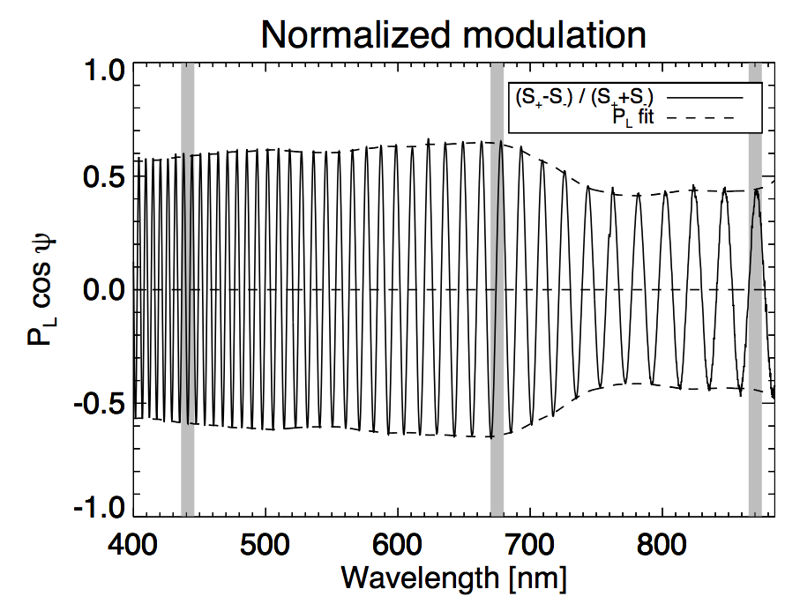
Ground based measurements
groundSPEX van Harten+, AMT, 2014

Slide 13
Ground based measurements
groundSPEX van Harten+, AMT, 2014
Notes:
Retrieval based upon radiance and DoLP

Slide 14
Ground based measurements
groundSPEX van Harten+, AMT, 2014
Notes:
Retrieval based upon radiance and DoLP

Slide 15
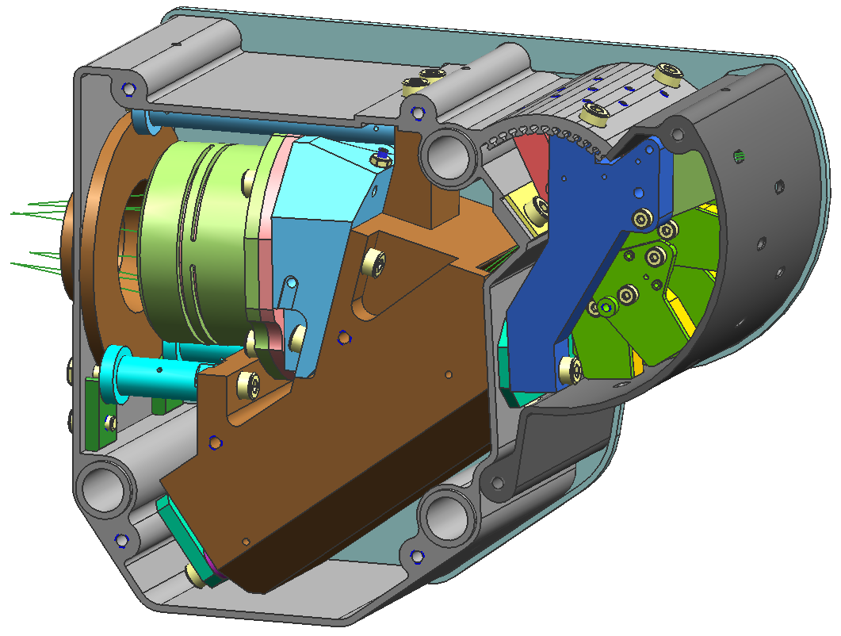
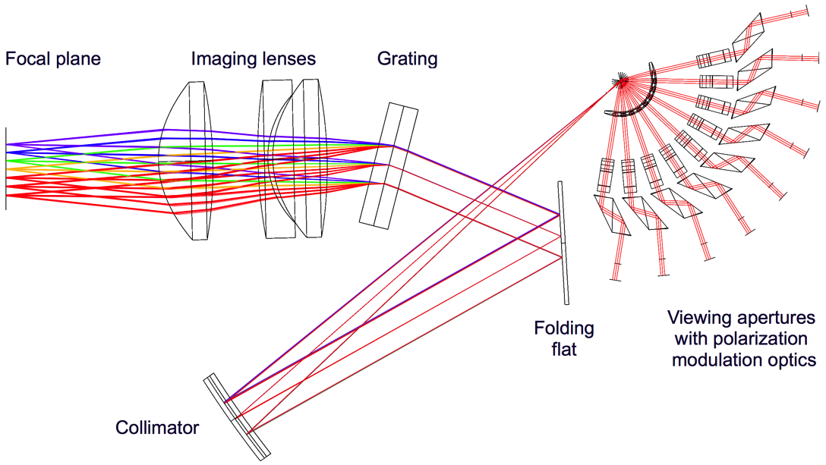
SPEX Prototype
9 viewing directions ; 1°×7°
Single spectrograph
400-800 nm
Volume 2 dm³
Mass 2 kg
Commercial detector
MECON
ASTRON / TNO

Slide 16
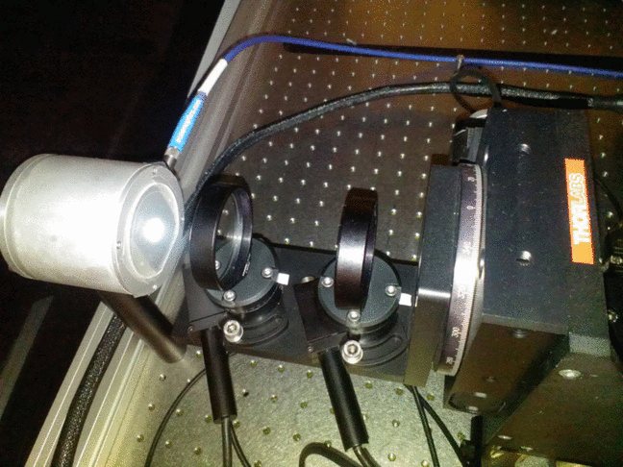
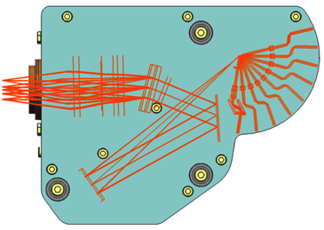
Polarization calibration: DoLP
DoLP
Retiga4000R

Slide 17
Polarization calibration

Slide 18
Polarization calibration
Design requirement: ΔP_{L} = 0.01+0.05•P_{L}
0.001+0.005•P_{L}

Slide 19
Polarization calibration
0.001+0.005•P_{L}
Prototype demonstrates the capabilities of the SPEX modulation technology!

Slide 20

SPEX Airborne
NASA ER-2 High Altitude Platform
21 km cruise height

Slide 21
SPEX Airborne
Instrument Control Unit
Instrument Power Unit
Structural Support Unit
SpectroPolarimeter Unit

Slide 22
Conclusions
Several implementations of spectral polarization modulation realized
SPEX Prototype performance beyond design requirements
High polarimetric accuracy needed for aerosol/climate science demonstrated in the lab and with ground-based clear sky observations
SPEX prototype upgraded for deployment on ER-2
First test + science flight ~2016Q1

