Slide 1
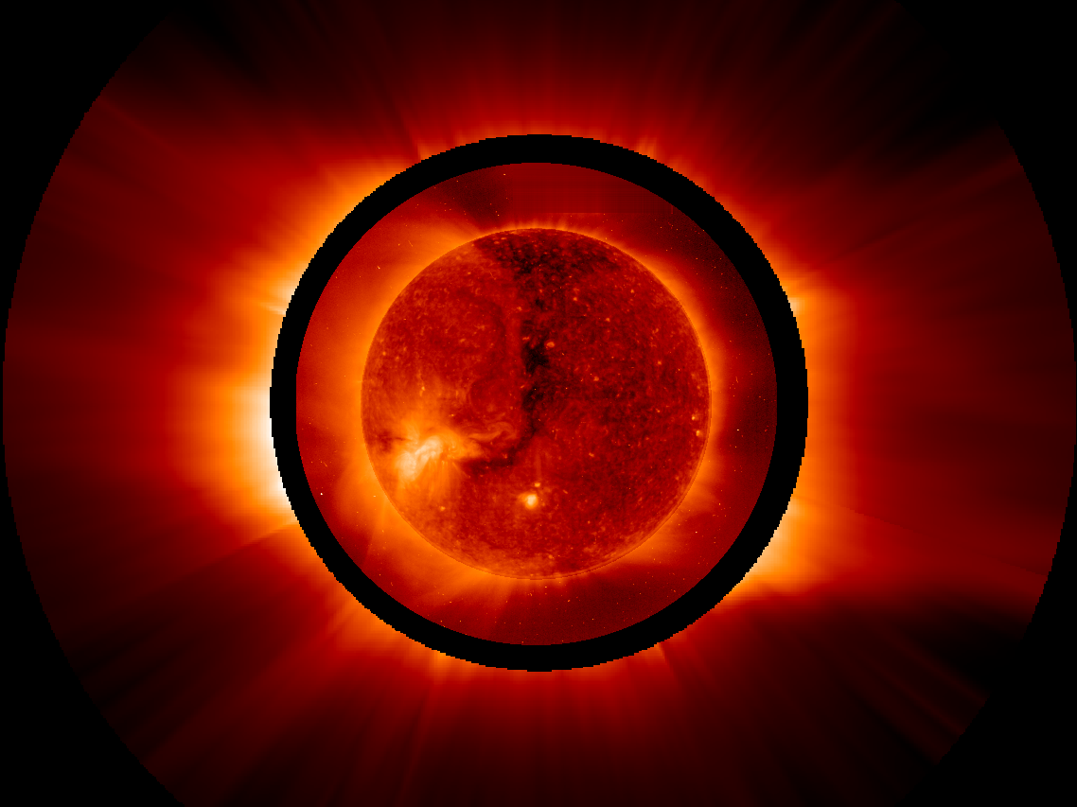
The Sun
Understanding our Star with Polarimetry
Silvano Fineschi
INAF – Astrophysical Observatory of Torino - Italy
Internatonal School of Astropolarimetry Centre Paul Langevin Aussois (F), 3-8 June 2013

Slide 2
The Solar Dynamo:
Powering the Sun’s magnetic field
In the Sun, the magnetic field generated by the dynamo mechanism plays a central role in the dynamics of the solar atmosphere.
Solar polarity reverses in about 11 years (solar cycle)
The plasma dynamics in the solar atmosphere goes from being dominated by thermal pressure (kT) over the magnetic pressure (B²) in the photosphere (1 < β = kT/ B²) to the opposite in chromosphere, corona ( 1 > β)

Slide 3
The Solar Magnetic Field:
Powering the Sun’s atmosphere
Magnetic reconnection powers solar flares and Coronal Mass Ejections
Magnetic waves (Alfven, acoustic)/reconnection (nanoflares) (TBD) power the solar wind

Slide 4
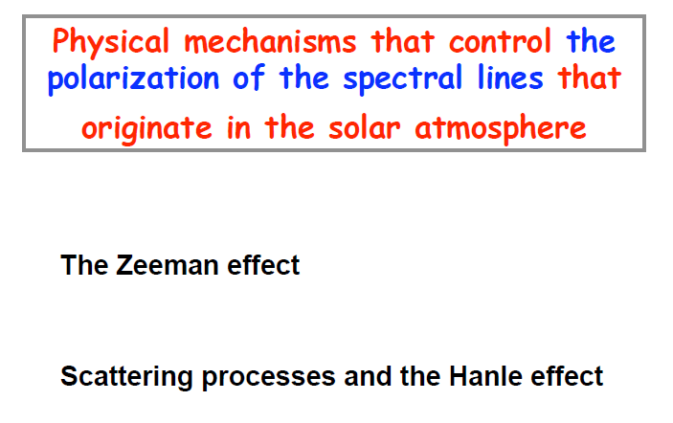

Slide 13
Solar Filter-Magnetograph

Slide 14
Solar Spectro-Polarimeter

Slide 16
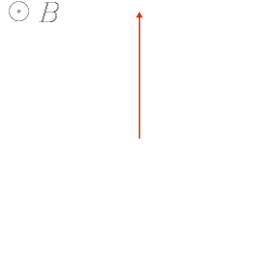
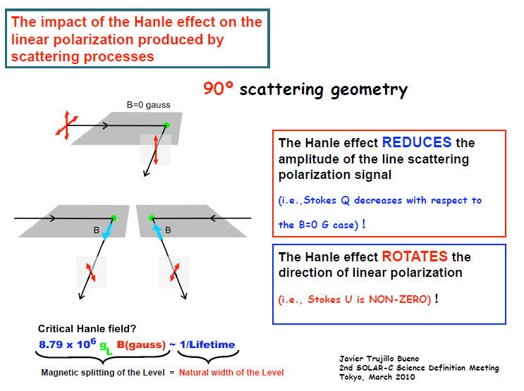
Hanle Effect (tutorial)
ω_{Larmour} << A
ω_{Larmour} ∼ A

Slide 17
Hanle effect in photospheric lines

Slide 18
Hanle effect in chromospheric
HI Lyman-α line

Slide 19
CLASP sounding-rocket: measuring the Hanle effect in HI Lyman-α

Slide 20
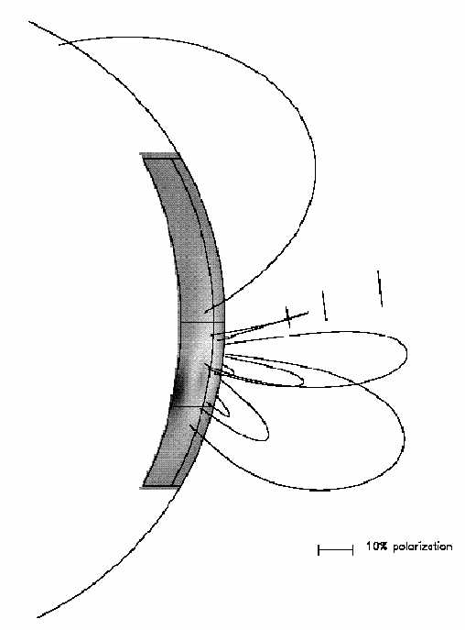
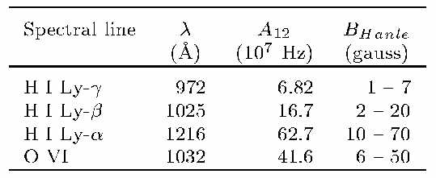
Hanle effect Sensitivity in coronal lines
A [10⁷ s⁻¹] ~ 0.88 ⋅ g_{J} ⋅ B [G]
A _{FeXIII} = 14 Hz ⇒ B_{Hanle} ∼ 0.2-2 μG
A _{FeXIII} << B_{corona} (“saturated” Hanle effect)
Fineschi, van Ballegooijen & Kohl, 1999

Slide 21
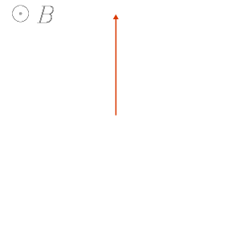
Hanle Effect (tutorial)
If ω_{Larmour} >> A (VIR forbidden lines)
ω_{Larmour} >> A
⇓
P is // or ⊥ B
A _{FeXIII} = 14 Hz ⇒ B_{Hanle} ∼ 0.2-2 μG
A _{FeXIII} << B_{corona} (“saturated” Hanle effect)

Slide 22
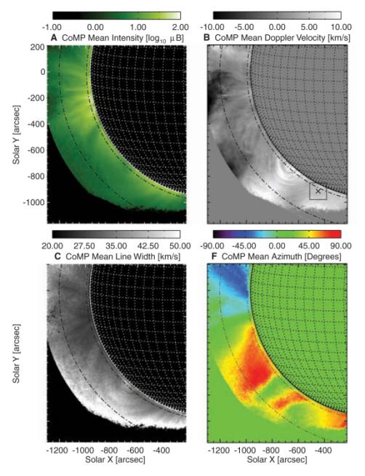
HAO CoMP
LC Lyot fiter & Polarimeter FeXIII 1047.4 nm «forbidden line»
S. Tomczyk, et al. Science 317, 1192 (2007);

Slide 23
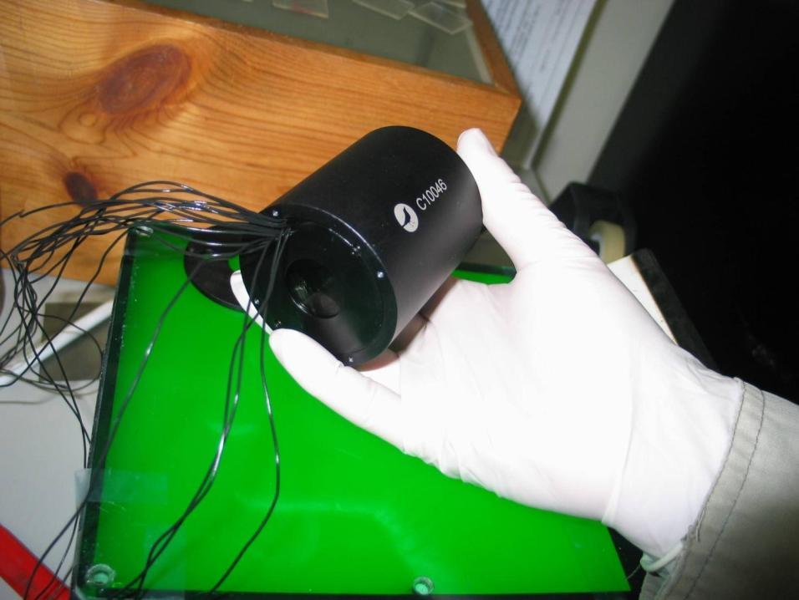
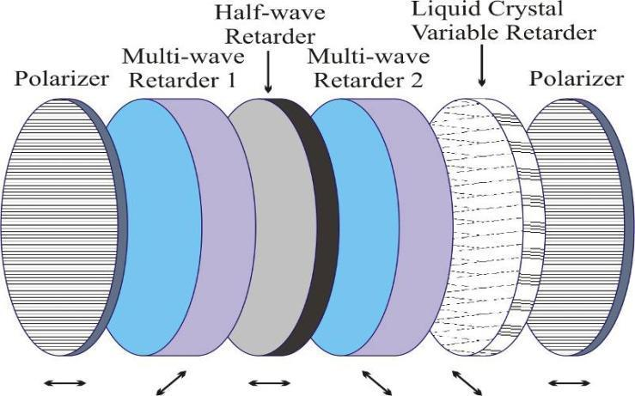

Slide 24
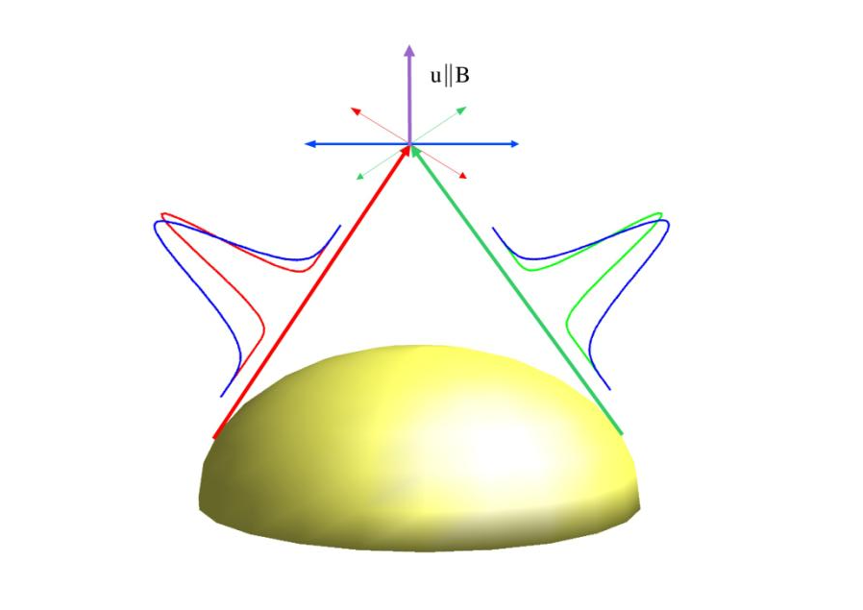
Resonance-scattering Polarization

Slide 25
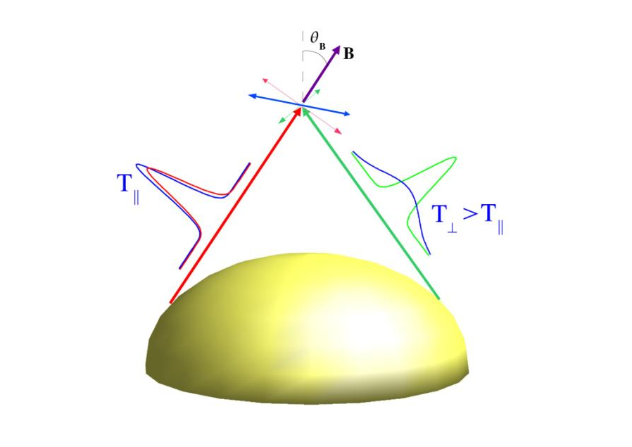
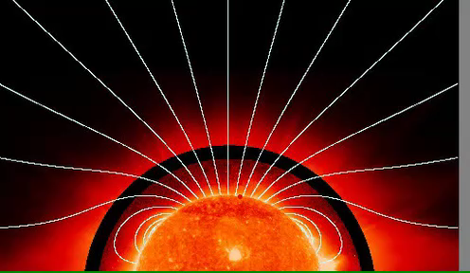

Slide 26

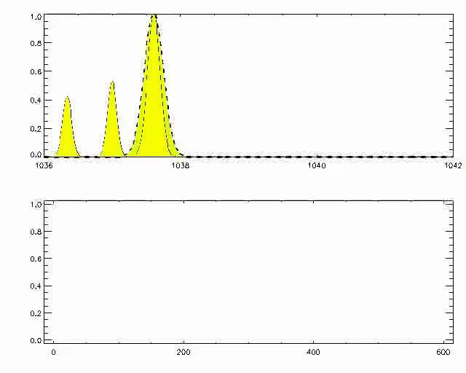
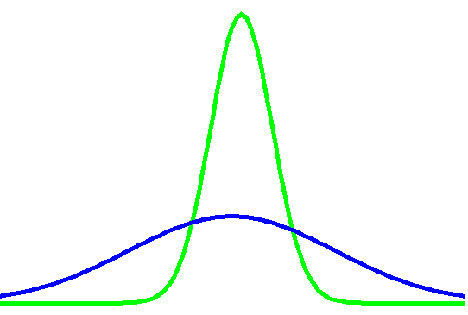
Anisotropic
Super-radial Doppler-dimming effect
OVI 103.7 nm Doppler-dimming; CII pumping (S. Giordano courtesy)
Fineschi, ASP Conf. Series, 2001

Slide 27
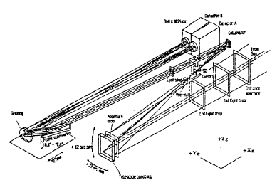
SUMER Measurement of Hanle and ASD effects?
P=(9±2)%; β= 9°±6°
Helioctr. Dist. = 1.3 R
Wind speed w ∼ 40 km/s
(Rauoafi A&A 1999)
Hanle effect: B > 10 G; θ_{B} < 10°; w > 50 km/s
SR Doppler-dim.: B < 3 G; θ_{B} > 30°; w > 50 km/s
Anisotr. SR Doppler-dim.: B <<1 G; θ_{B} ∼ 20°; w ∼ 40 km/s
(Fineschi ASP Conf. Series 2001)

Slide 28
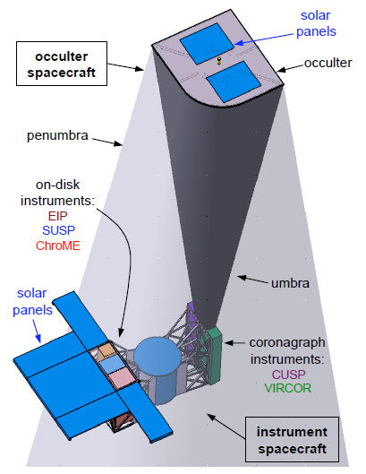
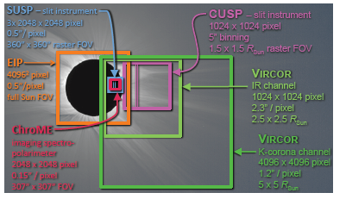
SolmeX – COMPASS
(ESA M-mission)
Peter, Fineschi et al. Exp. Astron. 2011

Slide 29
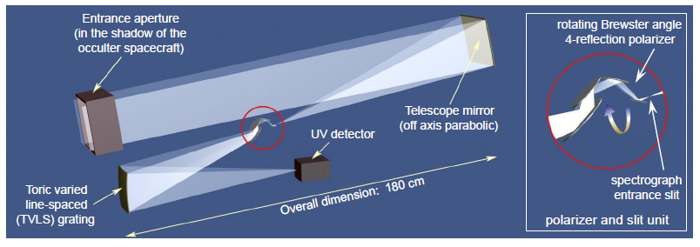
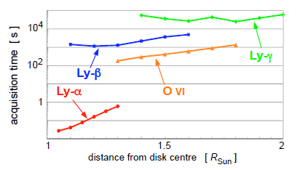
Coronal UV Spectro-Polarimeter (CUPS)

Slide 30
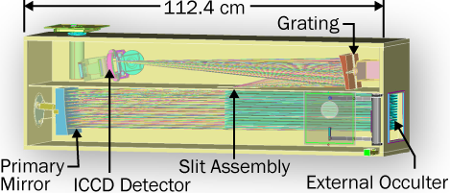
Non-Formation Flying CUPS
Telescope externally occulted
with multi-stacked apertures
Moses, et al. SPIE 2011

Slide 31
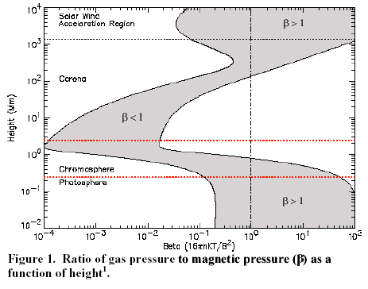
Beta
10 Ro
SolmeX
HI Lyman series, OVI 103.2 nm
& Fe IR lines
2 Ro
1.05 Ro
SUMI
CIV 150 nm
MgII h & k
280 nm
Temp. minimum
HI Ly-α 122 nm
CLASP
Photospheric VIR lines
Probing Coronal Magnetism with Space EUV/UV/VIR Polarimetry
Notes:
Yohkoh coronal X-ray images have shown that CME explosions are more likely to occur in regions having sigmoidal coronal magnetic fields than in regions with less contorted field configurations. The degree to which the contorted fields depart from a potential configuration, representing the free magnetic energy content of the region, is evidently a good indicator of whether a region will produce CMEs. This qualitative lead should be pursued. The free magnetic energy content of a region can be calculated from integrals over vector magnetograms, but accuracy depends on the fields being measured at a sufficient height in the atmosphere for them to be very nearly force free.
Also, the force-free fields in the transition region and corona may undergo large changes in direction without measurable
change in the photospheric roots. So, to follow the evolution of the 3D force-free field (both for CME studies and for more
general purposes), the vector magnetograms from which the field is extrapolated must be obtained from a force-free layer.
Therefore, a goal of SEC and LWS should be to measure the vector magnetic field in the middle to upper chromosphere
and/or lower transition region (See Figure 1).
The profiles of the MgII h and k lines at 2795 and 2803Å formed ~2900 km and at a temperature of ~2e4 K.
The CIV (2s-2p) lines, at 1548.2 and 1550.8 Å, are observed to have simple emission profiles that are formed ~200 km higher than the MgII lines and at a temperature of ~1e5 K.

